Slide 1
Multi-Physics OO Code
Leitao Liu

Slide 2
Introduction
Modules:
FEMGrid: read FEM grid (EasyMesh) to construct ‘Node’ and ‘Element’.
Device: physical constants, device parameters, device geometry structure
(device boundary markers, materials…)
Poisson: matrix assembly, Poisson solver.
DD: matrix assembly, DD solver.
Current: calculate current and heat generation.
Thermal: matrix assembly, thermal solver.
Mechanical: matrix assembly, mechanical solver.
CommonFunctions: commonly used functions (e.g. Fermi, dummy, anti_dummy…)

Slide 3
How to use the code?
Step 1: create objects
FEMgrid = FEMGrid(‘Input.n’, ‘Input.e’, length_scale); %construct ‘Node’ and ‘Element’
device = Device(FEMgrid); %specify device parameters
poissonobj = Poisson(device, FEMgrid); %K, S, Sad, B matrix assembly
ddobj = DD(device); %get the ‘device’ information
currentobj = Current(device); % get the ‘device’ information
thermalobj = Thermal(device, FEMgrid); %K, S, B matrix assembly

Slide 4
How to use the code?
Step 2：
while %electrical-thermal loop
U = poissonobj.PoissonSolver(0,0,0,1,Vg,Vd)
while %charge-Poisson loop
U_old = U;
%Vg(Vd) updates B, then solve the Poisson equation.
U = poissonobj.PoissonSolver(Fn_bias_old,Fp_bias_old,U_old,0,Vg,Vd);
%do matrix assembly in each iteration and solve DD equation.
[Ne_bias,Ph_bias,Fn_bias,Fp_bias] = ddobj.DDSolver(FEMgrid,Fn_bias_old,Fp_bias_old,U,T_old);
Fn_bias_old = Fn_bias; Fp_bias_old = Fp_ bias;
end
Ne(Vg,Vd) = Ne_bias; Ph(Vg,Vd) = Ph_bias;
%do a uniform interpolation and calculate current and heat generation.
[Id, Joule_heat, Xlin, Ylin] = currentobj.Current_Heat(FEMgrid,Ne_bias,Ph_bias,U,T_old);
%interpolate back to the original FEM grid and solve the thermal transport equation.
[T] = thermalobj.ThermalSolver(Joule_heat, Xlin, Ylin);
T_old = T;
end

Slide 5
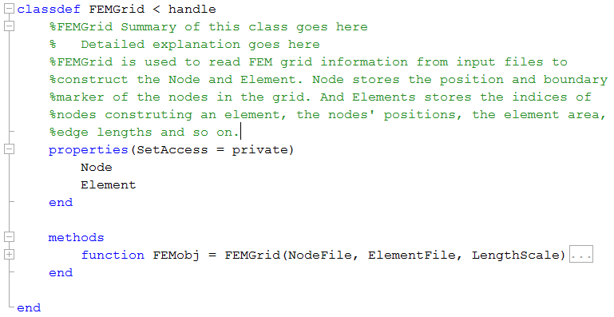
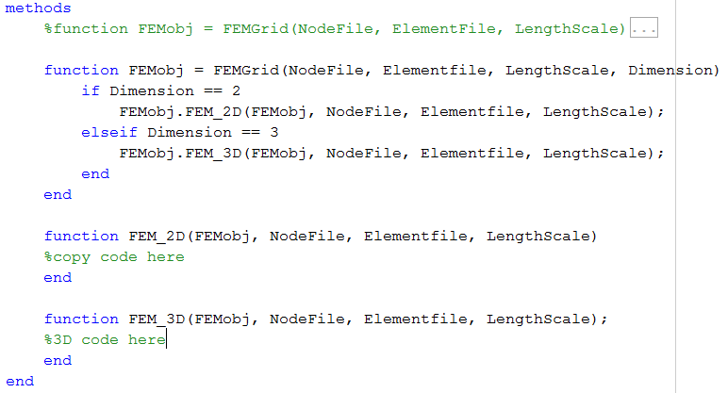
Class prototype
FEMGrid Extension: 3D grid

Slide 6
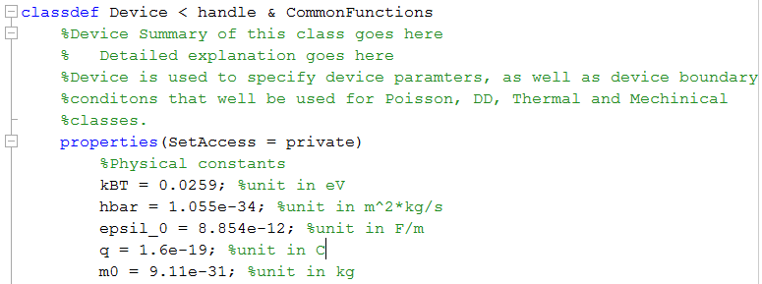
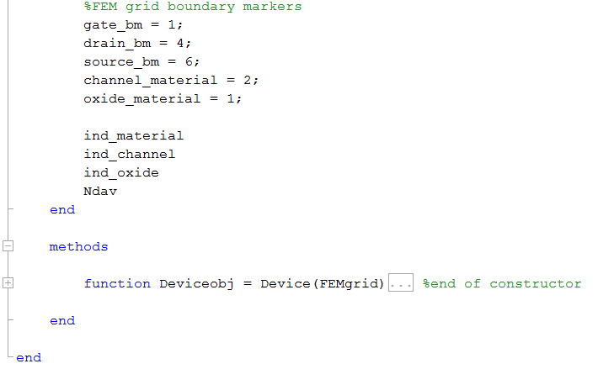
Class prototype
Device

Slide 7
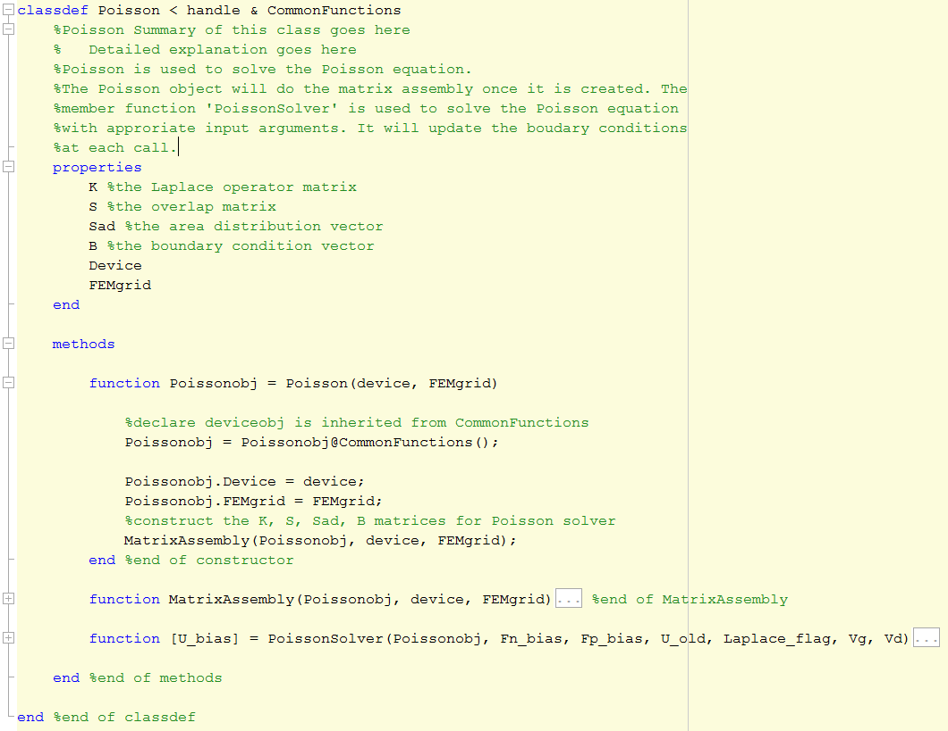
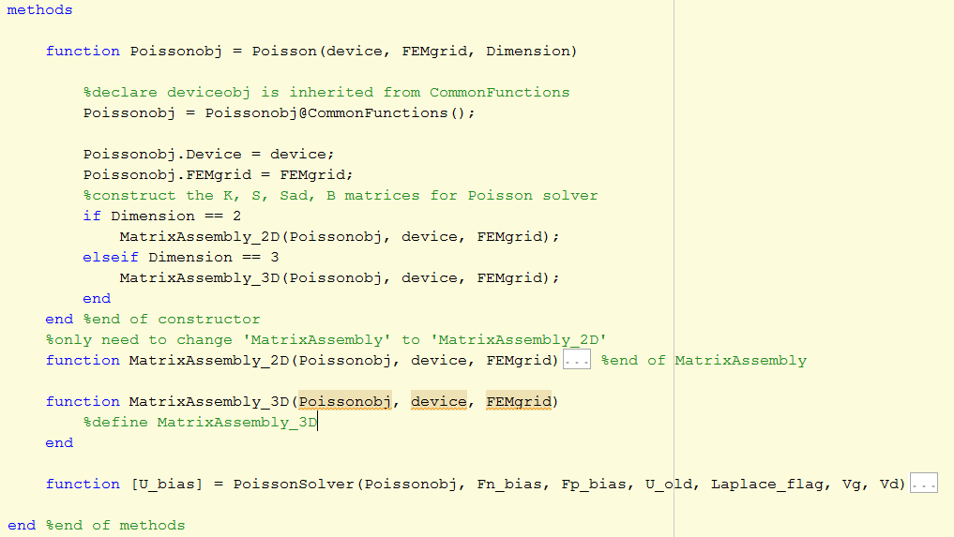
Class prototype
Poisson Extension: 3D

Slide 8
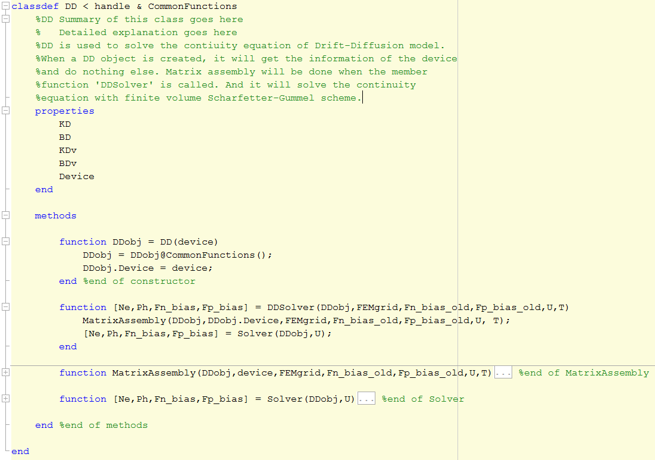
Class prototype
DD

Slide 9
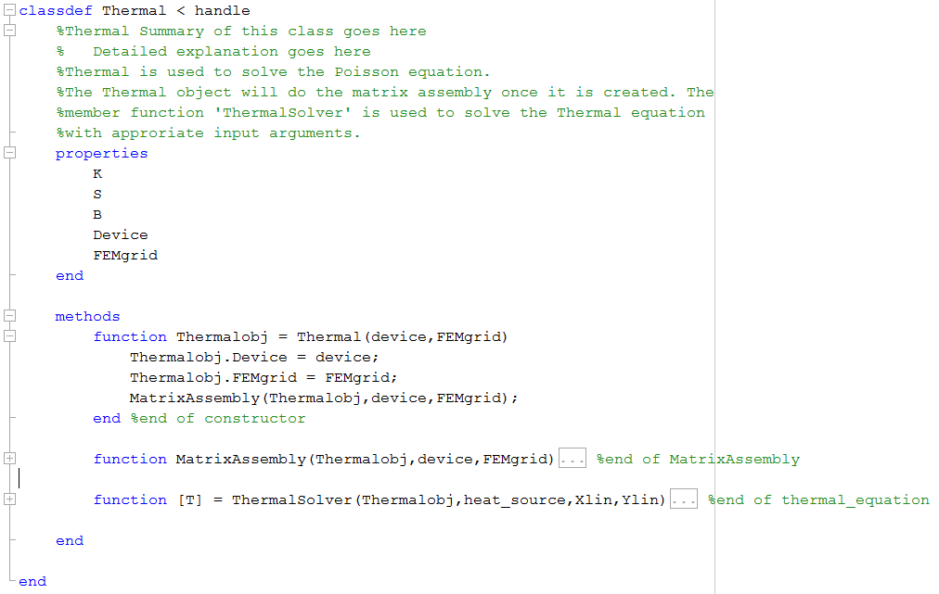
Class prototype
Thermal

Slide 10
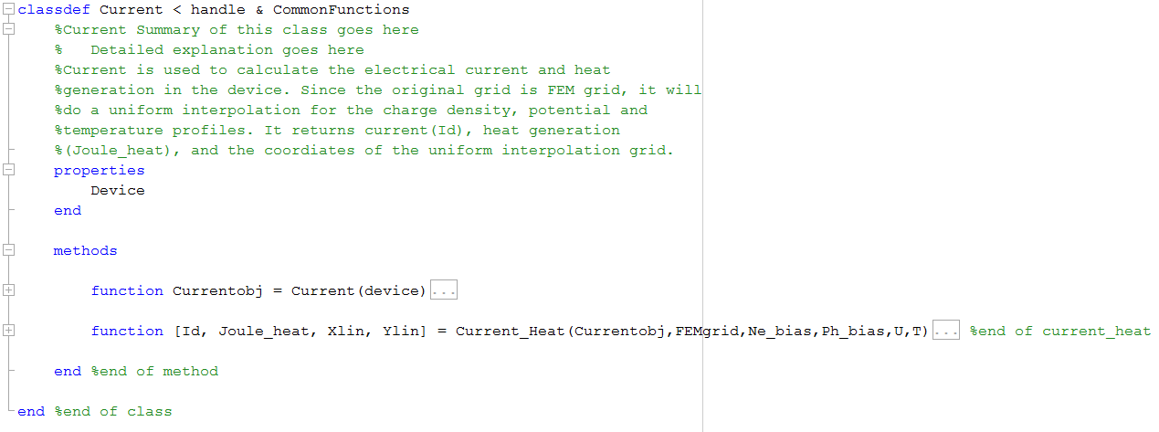
Class prototype
Current

Slide 11
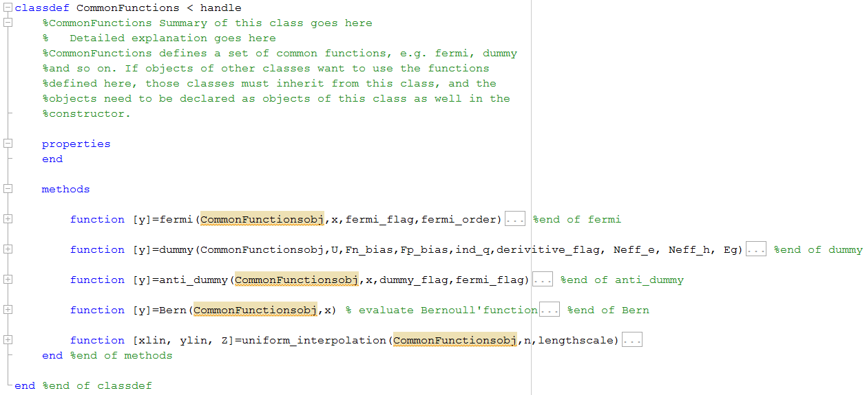
Class prototype
CommonFunctions

